Slide 1
Computational Models
The concept of a computational model
Basic computational models
The von Neumann computational model
Key concepts relating to computational models

Slide 2
The concept of a computational model
Model: Foundation or paradigm
Level of abstraction
Computational Model
Computer architecture
Computer language

Slide 3
Interpretation of concept of a computational model
Computational Model
(1) Basic items of computation
(2) Problem description model
(3) Execution model

Slide 4
(1) Basic items of computation
e.g. data, object, argument and functions, element of sets and the predicates

Slide 5
(2) Problem description model
Problem description model
Style
Method
Problem description style
Procedural
Declarative
Procedure style
(algorithm for solving the problem is stated)
Declarative style
(all the facts and relationships relevant to the given problem is stated)

Slide 6
Problem description style (e.g.)
Calculate n factorial, n!
Procedural style
int nfac (int n) {
int fac = 1;
if (n > 0)
for ( int i = 2; i <= n; i++ )
fac = fac * i;
return fac; }
Declarative style
fac (0) = 1;
fac ( n>0 ) = n * fac ( n-1 );

Slide 7
Declarative style
Using functions
in a model called applicative, (Pure Lisp)
Using predicates
in a model called predicate logic-based, (Prolog)

Slide 8
Problem description method
Procedural method
how a solution of the given problem has to be described
e.g. sequence of instructions
Declarative method
how the problem itself has to be described
e.g. set of functions

Slide 9
(3) Execution Model
Interpretation of how to perform the computation
related to the problem description method
Execution semantics
rule that prescribes how a single execution step is to be performed
Control of the execution sequence
ordering of execution sequence

Slide 10
Execution semantic
State transition semantics
Turing model
von Neumann model
object-based model
Dataflow semantics
dataflow model
Reduction semantics
applicative model (Pure Lisp)
SLD-resolution
Predicate logic-based model (Prolog)

Slide 11
Control of the execution sequence
Control driven
assumed that there exists a program consisting of sequence of instructions
execution sequence is then implicitly given by the order of the instruction
explicit control instructions to change the order
Data driven
an operation is activated as soon as all the needed input data is available (eager evaluation)
Demand driven
an operation is activated only when execution is needed to achieve the final result

Slide 12
Concepts of computational model, programming language, and architecture
Computational model
Implementation tool
Specification tool
Execution
Programming Language
Computer Architecture

Slide 13
Typical Evolution
Computation model
Corresponding programming language
Corresponding architecture

Slide 14
Basic computational models
Turing
von Neumann
object based
dataflow
applicative
predicate logic based

Slide 15
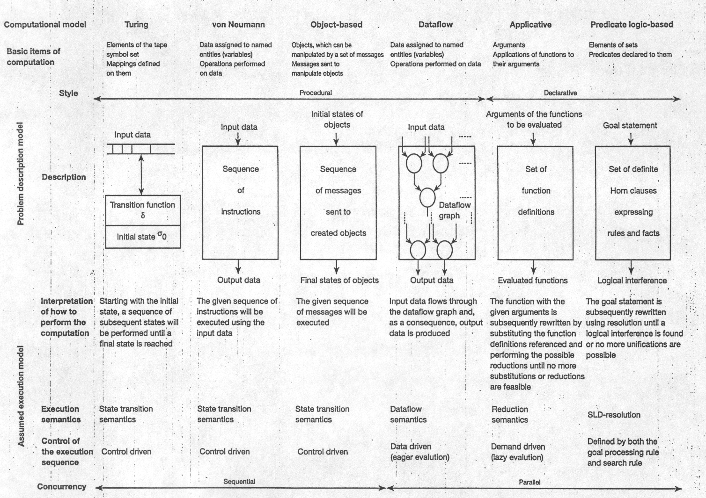
Key features of basic computational models

Slide 16
The von Neumann computational model
Basic items of computation are data
variables (named data entities)
memory or register locations whose addresses correspond to the names of the variables
data container
multiple assignments of data to variables are allowed
Problem description model is procedural (sequence of instructions)
Execution model is state transition semantics
Finite State Machine

Slide 17
von Neumann model vs. finite state machine
As far as execution is concerned the von Neumann model behaves like a finite state machine (FSM)
FSM = { I, G, δ, G₀, G_{f} }
I: the input alphabet, given as the set of the instructions
G: the set of the state (global), data state space D, control state space C, flags state space F, G = D x C x F
δ: the transition function: δ: I x G → G
G₀ : the initial state
G_{f} : the final state

Slide 18
Key characteristics of the von Neumann model
Consequences of multiple assignments of data
history sensitive
side effects
Consequences of control-driven execution
computation is basically a sequential one
++ easily be implemented
Related language
allow declaration of variables with multiple assignments
provide a proper set of control statements to implement the control-driven mode of execution

Slide 19
Extensions of the von Neumann computational model
new abstraction of parallel execution
communication mechanism allows the transfer of data between executable units
unprotected shared (global) variables
shared variables protected by modules or monitors
message passing
synchronization mechanism
semaphores
signals
events
queues
barrier synchronization

Slide 20
Key concepts relating to computational models
Granularity
complexity of the items of computation
size
fine-grained
middle-grained
coarse-grained
Typing
data based type ~ Tagged
object based type (object classes)

